Slide 1

Beer Game 2.0
Supply Chain Management Service Line
McKinsey and Company

Slide 2
Contents
Play guide
Debrief session - learnings
Appendix

Slide 3
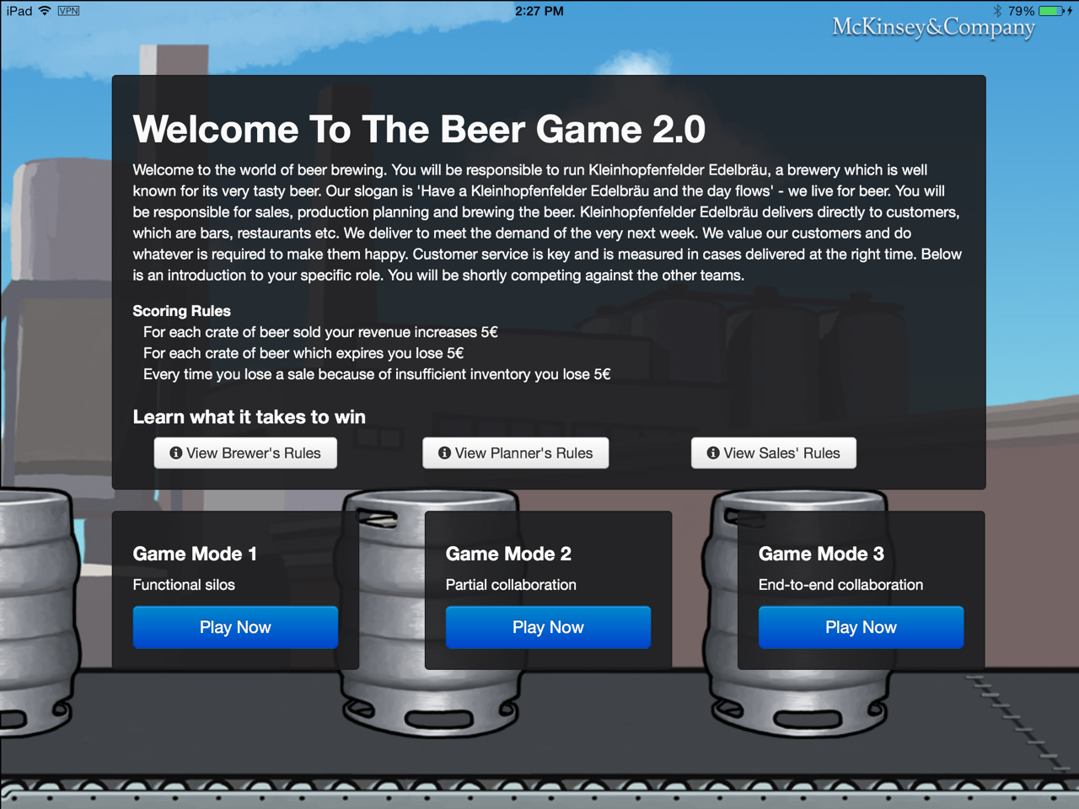
Please form yourself into groups of 6 people (4 groups assuming 24 people)
Group A and B will play in Mode 2, group C and D will play in mode 3
Instructions and incentives for each of the modes can be found on the ipad game as well as within this presentation.

Slide 4
How are the modes different?
Mode 1
Mode 2
Mode 3
Description
No transparency, incentives not aligned
Transparency, incentives not aligned
Transparency and aligned incentives
What does it mean?
Players do not disclose their incentive structure to each other
Individual incentives based on functional performance
Players should be instructed to maximize their own individual bonus
Players allowed to share each other's incentive structure
Individual incentives base on functional performance
Players should be instructed to maximize their own individual bonus
Player allowed to share each other’s incentive structure
Shared incentives across functions and aligned to business performance
Players instructed to maximize their own individual bonus
Group A and B will play the game in Mode 2
Group C and D will play the game in Mode 3
Each group will play the game for 20 rounds/ weeks

Slide 5
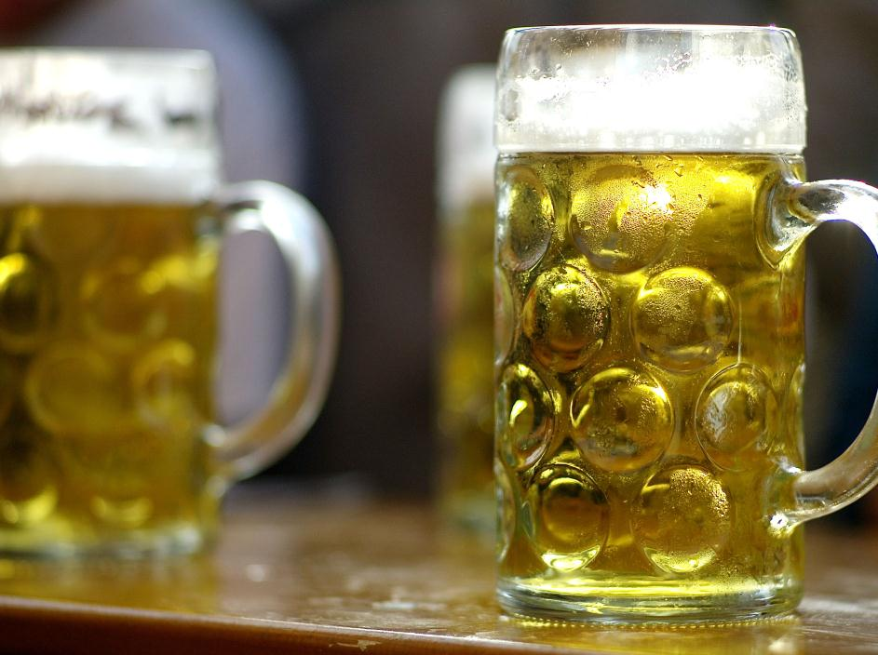
Setup and course of action
Beer Game 2.0. takes place in the context of operating the supply chain of “Kleinhopfenfelder Edelbräu”. KHE wants to identify the best supply chain management team from several competing teams.
Your supply chain management team consists of 3 different roles: Sales, Planning, and Production (Brewing). Objectives and incentive scheme are set for each of them and reviewed periodically. You decide weekly on sales forecast, plan, and production volume. According to the weekly results, the incentive score is updated.
We’ll play for 20 periods/ weeks. Mode 2 and Mode 3 teams will have a different set of rules.
Scoring:
For each crate of beer sold your company profit increases 5€
For each crate of beer that expires your company loses 5€
Every time you lose a sale (insufficient inventory) your company loses opportunity of 5€
Prepare your team:
Allocate team members (1 in Sales, 1 in Planning & 1 in Production)
Read about your role (think how to maximize your bonus)
Have fun

Slide 6
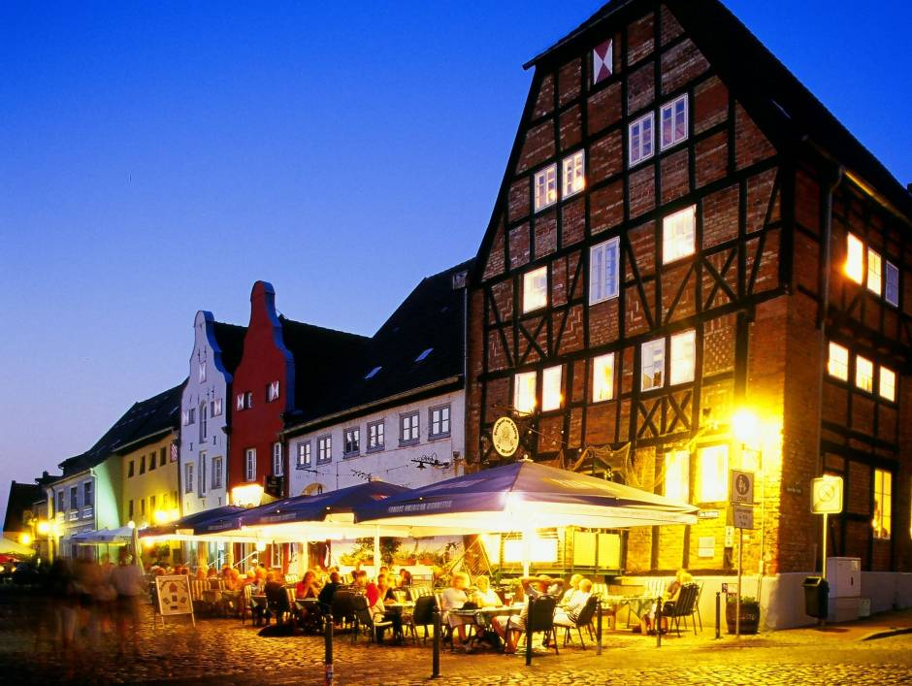
The challenge
You are in charge of Kleinhopfenfelder Edelbräu brewery’s supply chain
Your objective is to ensure beer supply at all times and maximize incentives
There are 3 roles: sales, planning, and production

Slide 7
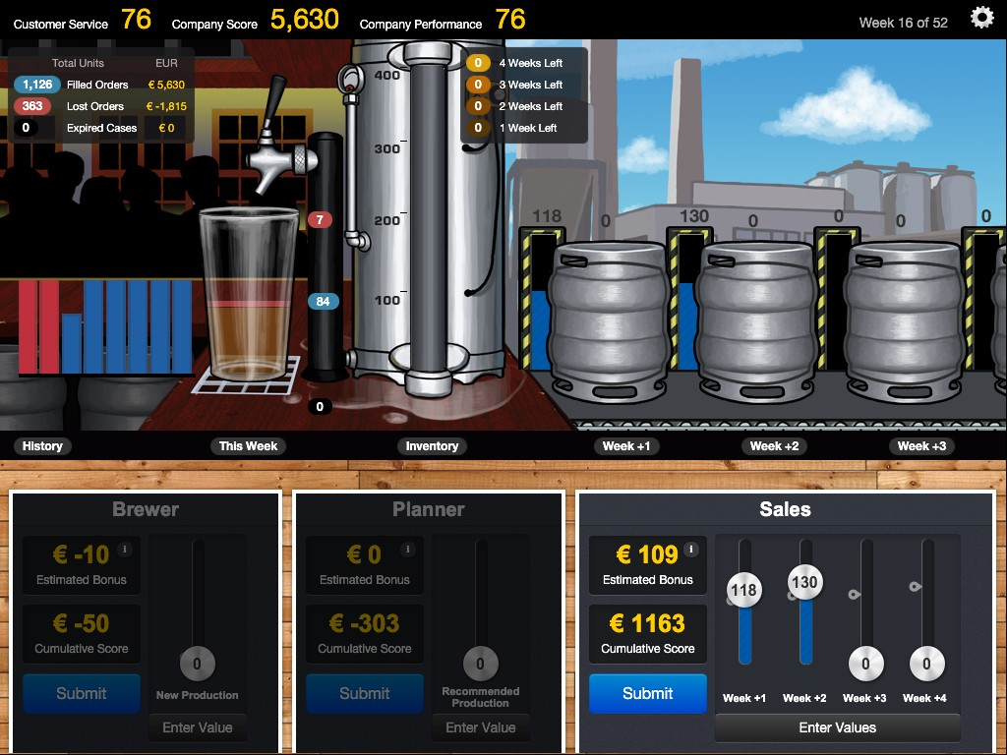
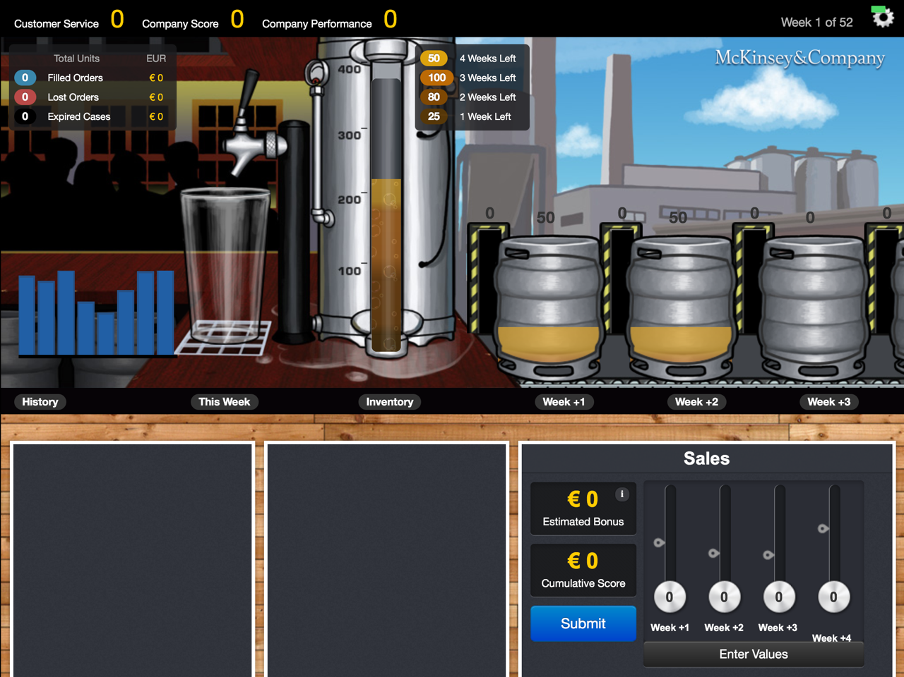
This is your supply chain cockpit – the ipad control tower
Note that this is the estimated bonus based on your decision (and your teams decision so far)
You may or may not achieve this number based on the actual sales for this period

Slide 8
This is your supply chain cockpit – the ipad control tower
History of demand and beer delivery
Beer demand / delivery
this week
Note: orders filled, lost and expiry\
Cum. Nos. available in top left
Beer Inventory
to fulfil orders
Note: stock age profile – beer expires after 4 wks
You can sell only from existing stock – next weeks production does not go to sales
Beer production pipeline
Note: 3 week production process

Slide 9
This is your supply chain cockpit – the ipad control tower
Cumulative order status
Company performance
Forecasts as filled by sales team
Displays week
Press the star to end game
Company score = Company profit = (Filled orders – Expired cases) x 5€
Company possible profit = (Filled orders + Lost orders) x 5€
Company performance = Company profit / Company possible profit [expressed as %]
Customer service = Filled orders / (Filled orders + Lost orders) [expressed as %]

Slide 10
3 decisions need to be taken in each week
Step 3: Brewer
Brewer decides on how much to undertake
Remember, production process is 3 wks long
Note: your personal incentive, a function of your decision can be seen real time
You can also find the bonus logic via the information button next to bonus
Step 2: Planner
Inventory takes information from the forecast entered by sales team, checks the inventory levels and places demand requirement for the brewer
Note: your personal incentive, a function of your decision can be seen real time
You can also find the bonus logic via the information button next to bonus
Step 1: Sales
Sales team inputs forecast for the next 4 weeks based on the sales history
You can enter the forecast by adjusting the sliders or putting in the actual numbers
To assist the sales team statistically generated forecast indicators are provided
Note: your bonus can be seen real time

Slide 11
Sales’ rules
PRINTOUT TO BE SHARED WITH RESPECTIVE PARTICIPANTS
Your job is to sell as much beer as possible
Your job is to provide sales forecasts to the Planner on how much beer you expect to sell over the next 4 weeks (to help you, you will be provided with a forecast from your customers)
Orders come in for next week, if they cannot be fulfilled we will miss the sales
We sell 100 cases per week on average
We do not sell beer older than 4 weeks, we scrap it
Some figures:
Each case sells for €10
Gross margin is 50% (€5 per case)
For each expired case (> 4 weeks old) we lose €5
Your incentives for each mode will be explained during the game (bonus help text “i”)
As with any job, think about how you can maximise your salary/ bonus

Slide 12
Planner’s rules
PRINTOUT TO BE SHARED WITH RESPECTIVE PARTICIPANTS
Our job is to manage the warehouse inventory and provide input on production needs
You will use current inventory status and sales forecast (4 weeks) to make recommendations (remember that a beer batch takes 3 weeks to make)
If we have less inventory than orders, we lose sales
If we have inventory older than 4 weeks, we will have to scrap it
Your boss told you to keep inventory in strict limits
Your incentives for each mode will be explained during the game (bonus help text “i”)
As with any job, think about how you can maximise your salary/ bonus

Slide 13
Brewer’s rules
PRINTOUT TO BE SHARED WITH RESPECTIVE PARTICIPANTS
Our beer is made in our local brewery and is ‘born’ 3 weeks before it is ready to be shipped to the warehouse
You manage production
You are provided with production recommendations and decide how much beer to start this week
Fermentation tanks have max. capacity of 150 cases (above average demand of 100 cases)
Any quantity from 0-150 cases can be made per week
Product older than 4 weeks has to be disposed of (loss of 5€ / crate)
Your job is to keep brewing costs per case low (full utilisation of brewing tanks)
Your incentives for each mode will be explained during the game (bonus help text “i”)
As with any job, think about how you can maximise your salary/ bonus

Slide 14
Note down end products after 5,10, 15 and 20 weeks
Note the following parameters once you end the game:
Customer service
Company performance
Total company score
Total sales bonus
Total planning bonus
Total brewer’s bonus
Observe the sales pattern and the deviation from the forecast on the weekly basis
Observe the production trend over the last 20 weeks
Pl. note these two before pressing end game button
These parameters will be available on the result screen (on next slide)

Slide 15
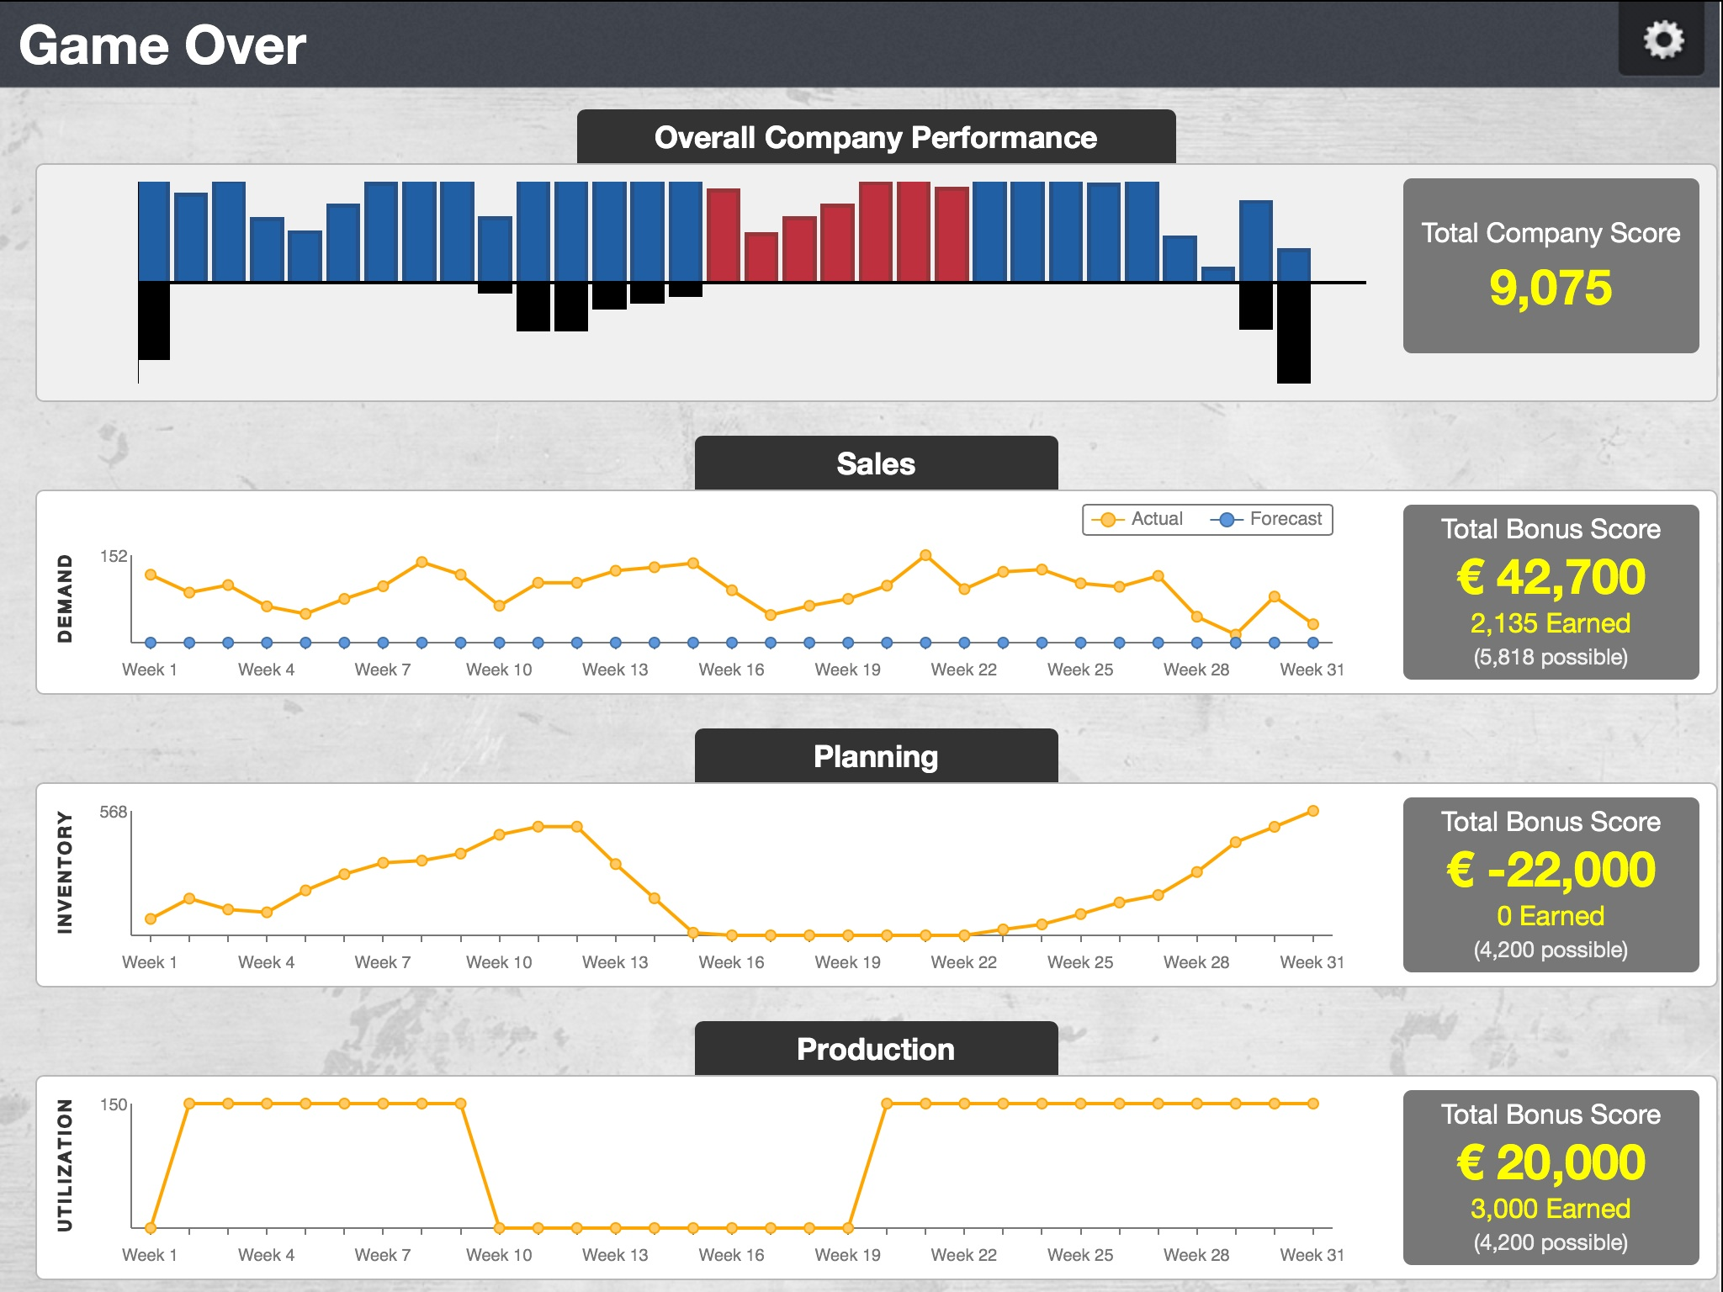
Note these figures
Bonus = cumulative score x 100

Slide 16
Let’s play
Start the game
Online tutorials available when you start the game
This is just to familiarize with the game – have fun and also make loads of virtual money for yourself!!

Slide 17
Game logistics
5 min - Intro to the game (description, assign & read roles)
10 min - Familiarization with the game
30 min - Compete (each team to record their performance at the end of 15 weeks)
10 min - Debrief (compare results & takeaways)
Special prizes for
Salesperson of the year
King planner
Super producer
Best company performance
55 min

Slide 18
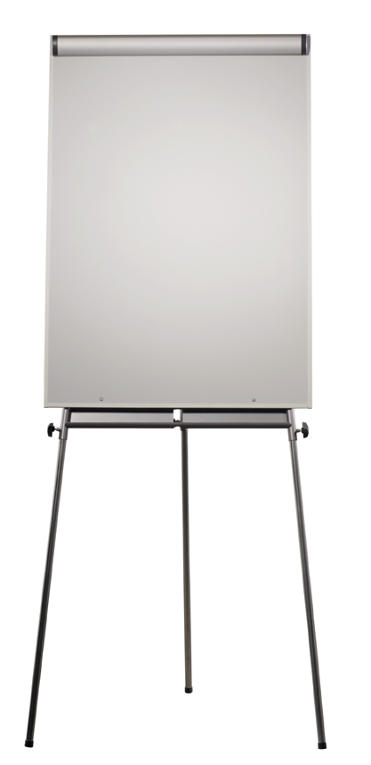
Results
To be filled for end of week 5, 10, 15 and 20
Prizes based on results of week 20
QUELLE: Quelle

Slide 19
Contents
Play guide
Debrief session - learnings
Appendix

Slide 20
Typical results
Place holder with actual screen shots of the results /// Mode 2 and mode 3
Common observations
Sales teams always make good bonus (compared to other functions)
Are you setting the right incentive structures?
Planners don’t really control the inventory build up
Is that true for BAT?
Companies and individuals perform better when incentives are aligned and there is trust and transparency
QUELLE: Quelle

Slide 21

Debrief
Where you successful in achieving your objectives?
What worked better than in the previous period?
Why it worked better?
Do you see a value proposition for your clients?
Who won?

Slide 22

TO BE SHARED DURING BRIEFING SECTION
Key learning
Importance of transparency
Silo optima do not create optimal flow

Slide 23

TO BE SHARED DURING BRIEFING SECTION
Key learning
Importance of alignment
Power of shared objectives
Challenges of supply chain management

Slide 24

TO BE SHARED DURING BRIEFING SECTION
Key factors for transparency and alignment
Shared information
Communication/performance dialog
Feedback loops
Matching and balanced KPIs
Shared objectives/incentives

Slide 25
Contents
Play guide
Debrief session - learnings
Appendix
Incentive cards

Slide 26
Contents
Play guide
Debrief session - learnings
Appendix
Incentive cards

Slide 27
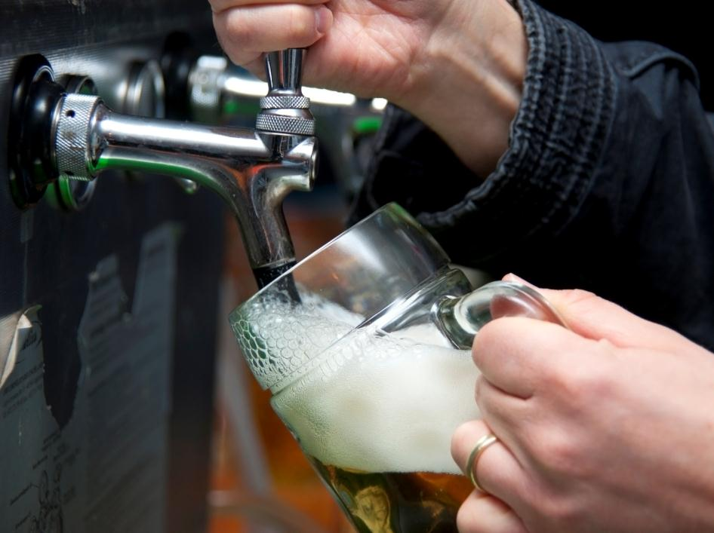
Mode 2 – details and incentives for sales
Share your incentive with the others You are paid on provision
For each case sold you make 1€
Your job is to provide to P. Planner how much beer you expect to sell over the next 4 weeks
To help you, you will be provided with a forecast for the same time period by your customers
Orders come in for next week. If they cannot be fulfilled, we will miss sales – that means thirsty customers and less income
Your objective Maximize the amount of money you make

Slide 28
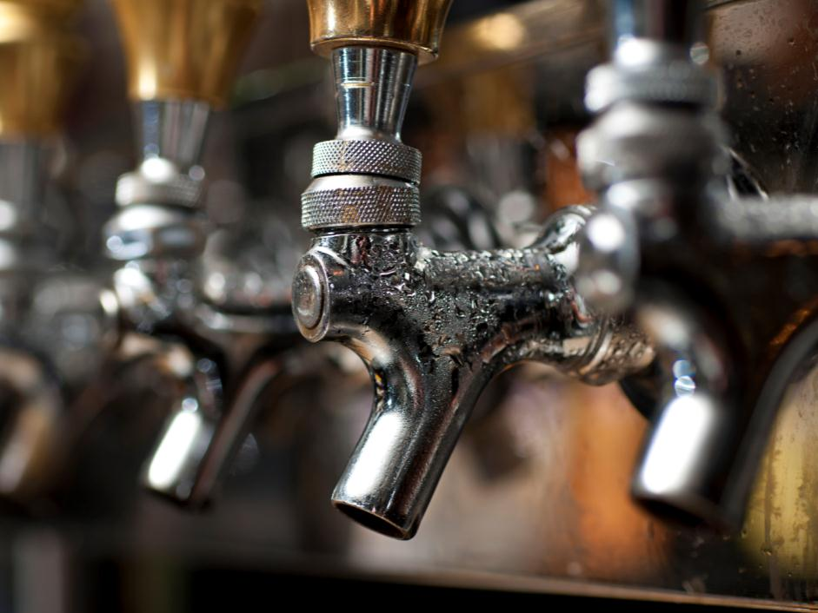
Mode 2 – details and incentives for planning
Share your incentive with the others You will get paid a bonus on inventory level!
You will get paid 10€ bonus for every week where inventory is under 200
Expiring product will deduct 1€ per case from your bonus
You manage the inventory and provide input on production needs
Use current inventory and sales forecast to make the production plan
Remember, a beer batch takes 3 weeks to make and if inventory is older than 4 weeks, we will have to discard
If we have less inventory than orders, we lose sales
Your objective Maximize the amount of money you make

Slide 29
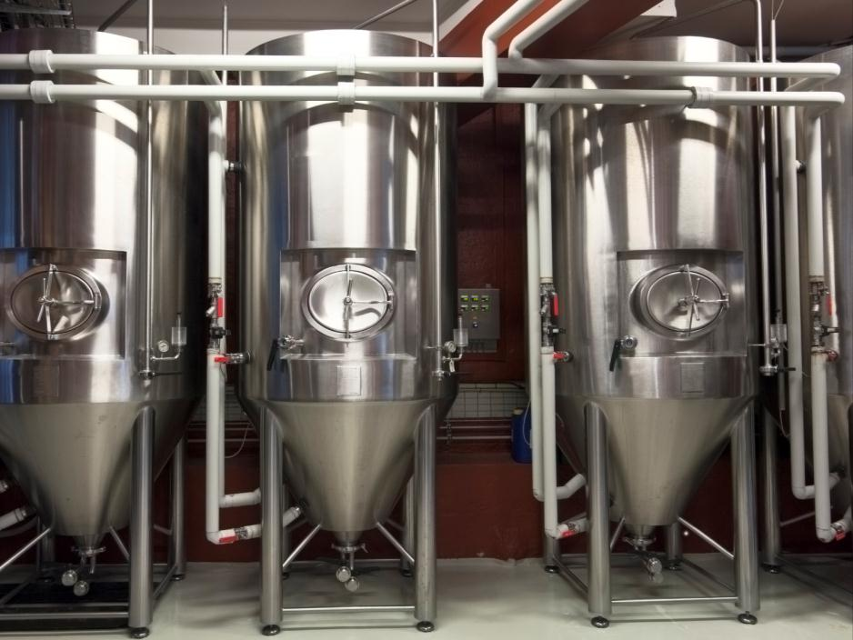
Mode 2 – details and incentives for production
Share your incentive with the others You will get paid a bonus on capacity utilization
10€ if you launch more than 130 cases
Nothing if you launch between 110-130 cases or if you decide to produce nothing (we can force our workers to take a vacation day)
10€ penalty if you launch some, but less than 110 cases
You are provided with a production plan and decide how much beer to start producing this week
Our 3 fermentation tanks have a maximum capacity of 150 cases
Any quantity from 0-150 cases can be made
Your objective Maximize the amount of money you make

Slide 30
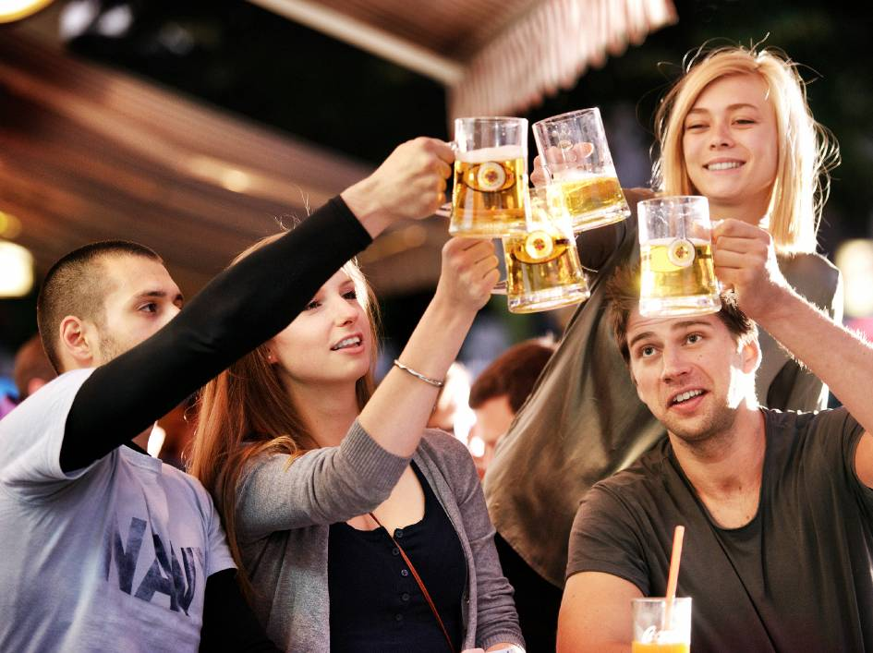
Mode 3 – details and incentives for sales
You are allowed to share You are paid on overall profit
For each case sold, you make 50 ct
You are paid an additional incentive to provide good forecasts to planning
For each week where your aggregate 4-week forecast was +/-10% accurate, you receive 100€ +/-20% accurate, you receive 50€ and if less accurate, you receive nothing
Supply chain and other business details are the same like in the previous years
Your objective Maximize the amount of money you make

Slide 31
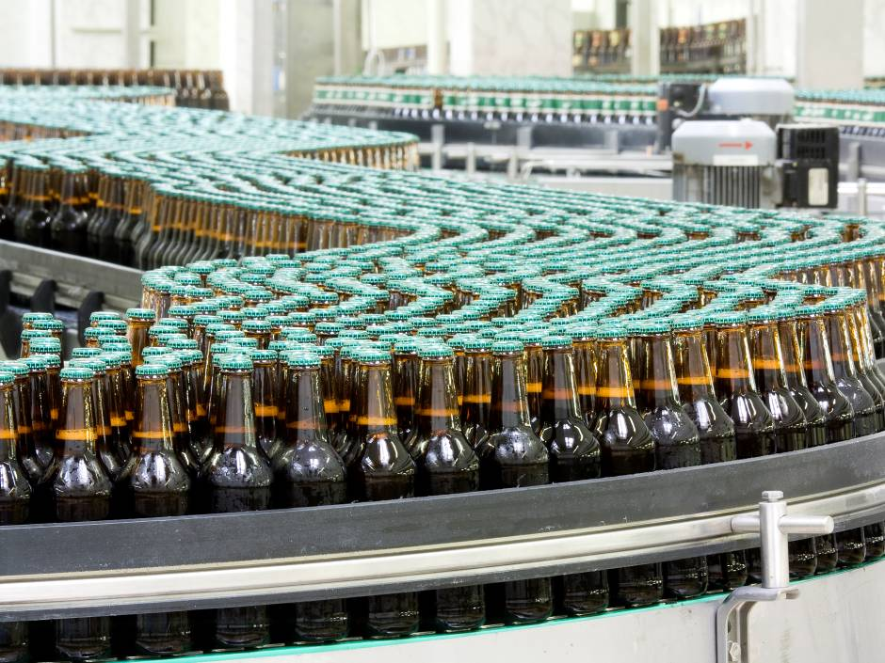
Mode 3 – details and incentives for planning
You are allowed to share You will get paid a bonus on inventory level
You manage the inventory and provide input on production needs
Your job is to optimize the inventory: minimum inventory is 100 cases and maximum inventory is 300 cases
Less inventory than orders results in lost sales
You will get paid 10€ bonus for every week where inventory is between 100 and 300 cases
Expiring product will deduct 1€ per case from your bonus
For every case not sold, you receive a deduction of 1€
Your objective Maximize the amount of money you make

Slide 32
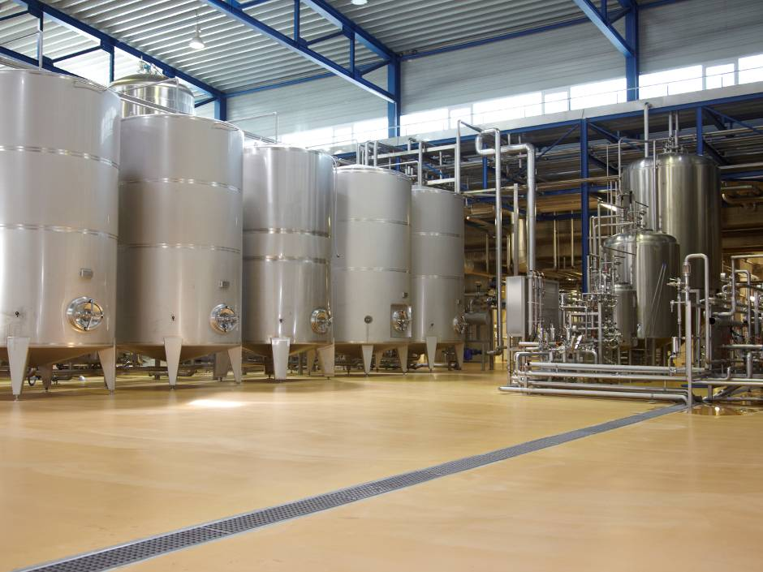
Mode 3 – details and incentives for production
You are allowed to share You will get paid a bonus on capacity utilization
Production can influence overall profit by utilizing the batch sizes of the 3 fermenters as good as possible
Maximum batch size equals 50 crates
Production cost (labor, energy, plant time) is nearly constant per batch and indepen-dent of batch size
You get a bonus of 10€ on 100% utilization, which is 50, 100, or 150 crates produced
You receive a penalty on utilization below <90%, which is 101-134, 51-89, or 0-44 crates
Your objective Maximize the amount of money you make

